Slide 1
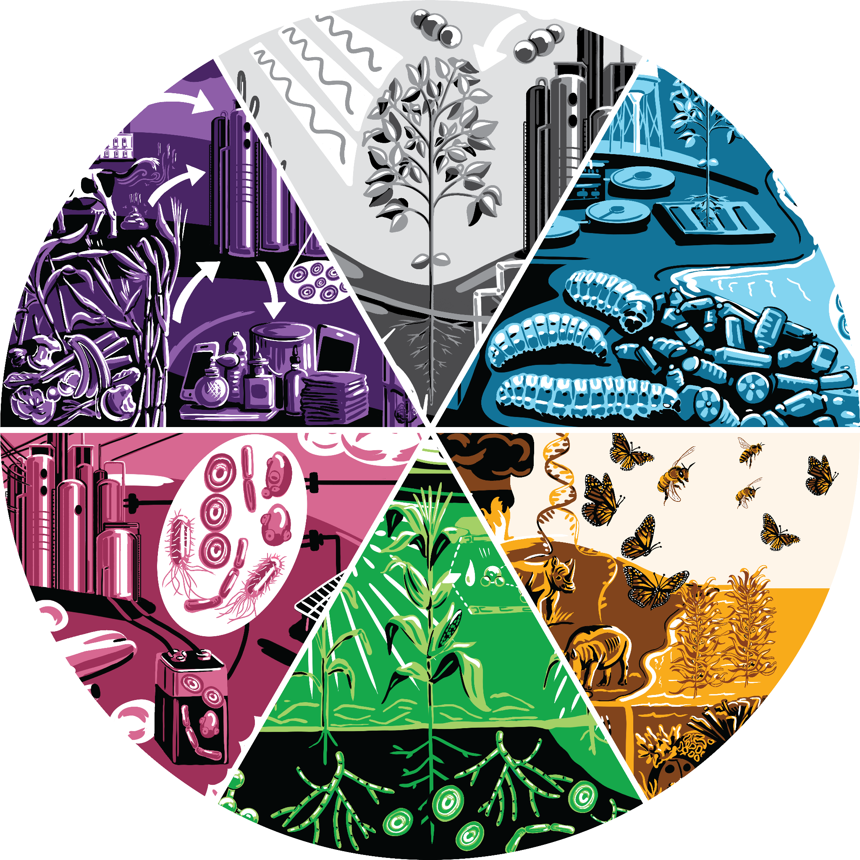
Engineering Biology for Climate & Sustainability
A Research Roadmap for a Cleaner Future
https://roadmap.ebrc.org
Technical Roadmap:
Part 1: Developing Novel Capabilities for Climate Change Mitigation and Ecosystem Resilience
Part 2: Enabling Sustainable, Climate-friendly Production in Application Sectors
Case Studies: Social and Nontechnical Dimensions
Glossary
©2022 Engineering Biology Research Consortium
This material is based upon work supported by the National
Science Foundation under Award nos. 1818248 and 2116166.

